Slide 1

Guide: Priyanga K K
TEAM:
Alfi Thomas
Sreehari K B
Anurenjitha K T

Slide 2
Introduction
→ Steganography is the practice of concealing a message ,image, or file within another message ,image , or file . The goal of steganography is to communicate a secret message in such a way that it is not detectable by outsiders.
→ Cryptography is the practice of secure communication by encoding messages in such a way that they can only read by the intended recipient. Cryptography aims to protect a message's confidentiality , integrity , and authenticity from unauthorized access or tampering.
→ Together, steganography and cryptography can be used to securely transmit sensitive information without detection .

Slide 3
Topic Elucidation
ENCRYPTION:
→ This algorithm makes use of traditional as well as modern symmetric encryption techniques and combines them with LSB Steganography to provide a secure way of transferring data through a public channel.
→ The user is allowed to choose one traditional encryption algorithm from three such algorithms. At this stage, the user will have to enter a key (Key 1) for the encryption process.
→ the first stage of encryption, the message now moves to the final round of encryption, the customized triple AES encryption algorithm. At this stage, the user is supposed to enter the second key (Key 2).
→ After the two rounds of encryption, the encrypted text message is made to go through the LSB Steganography technique.
→ Results are evaluated through the mean square error (MSE) and the signal-to-noise ratio (PSNR).

Slide 4
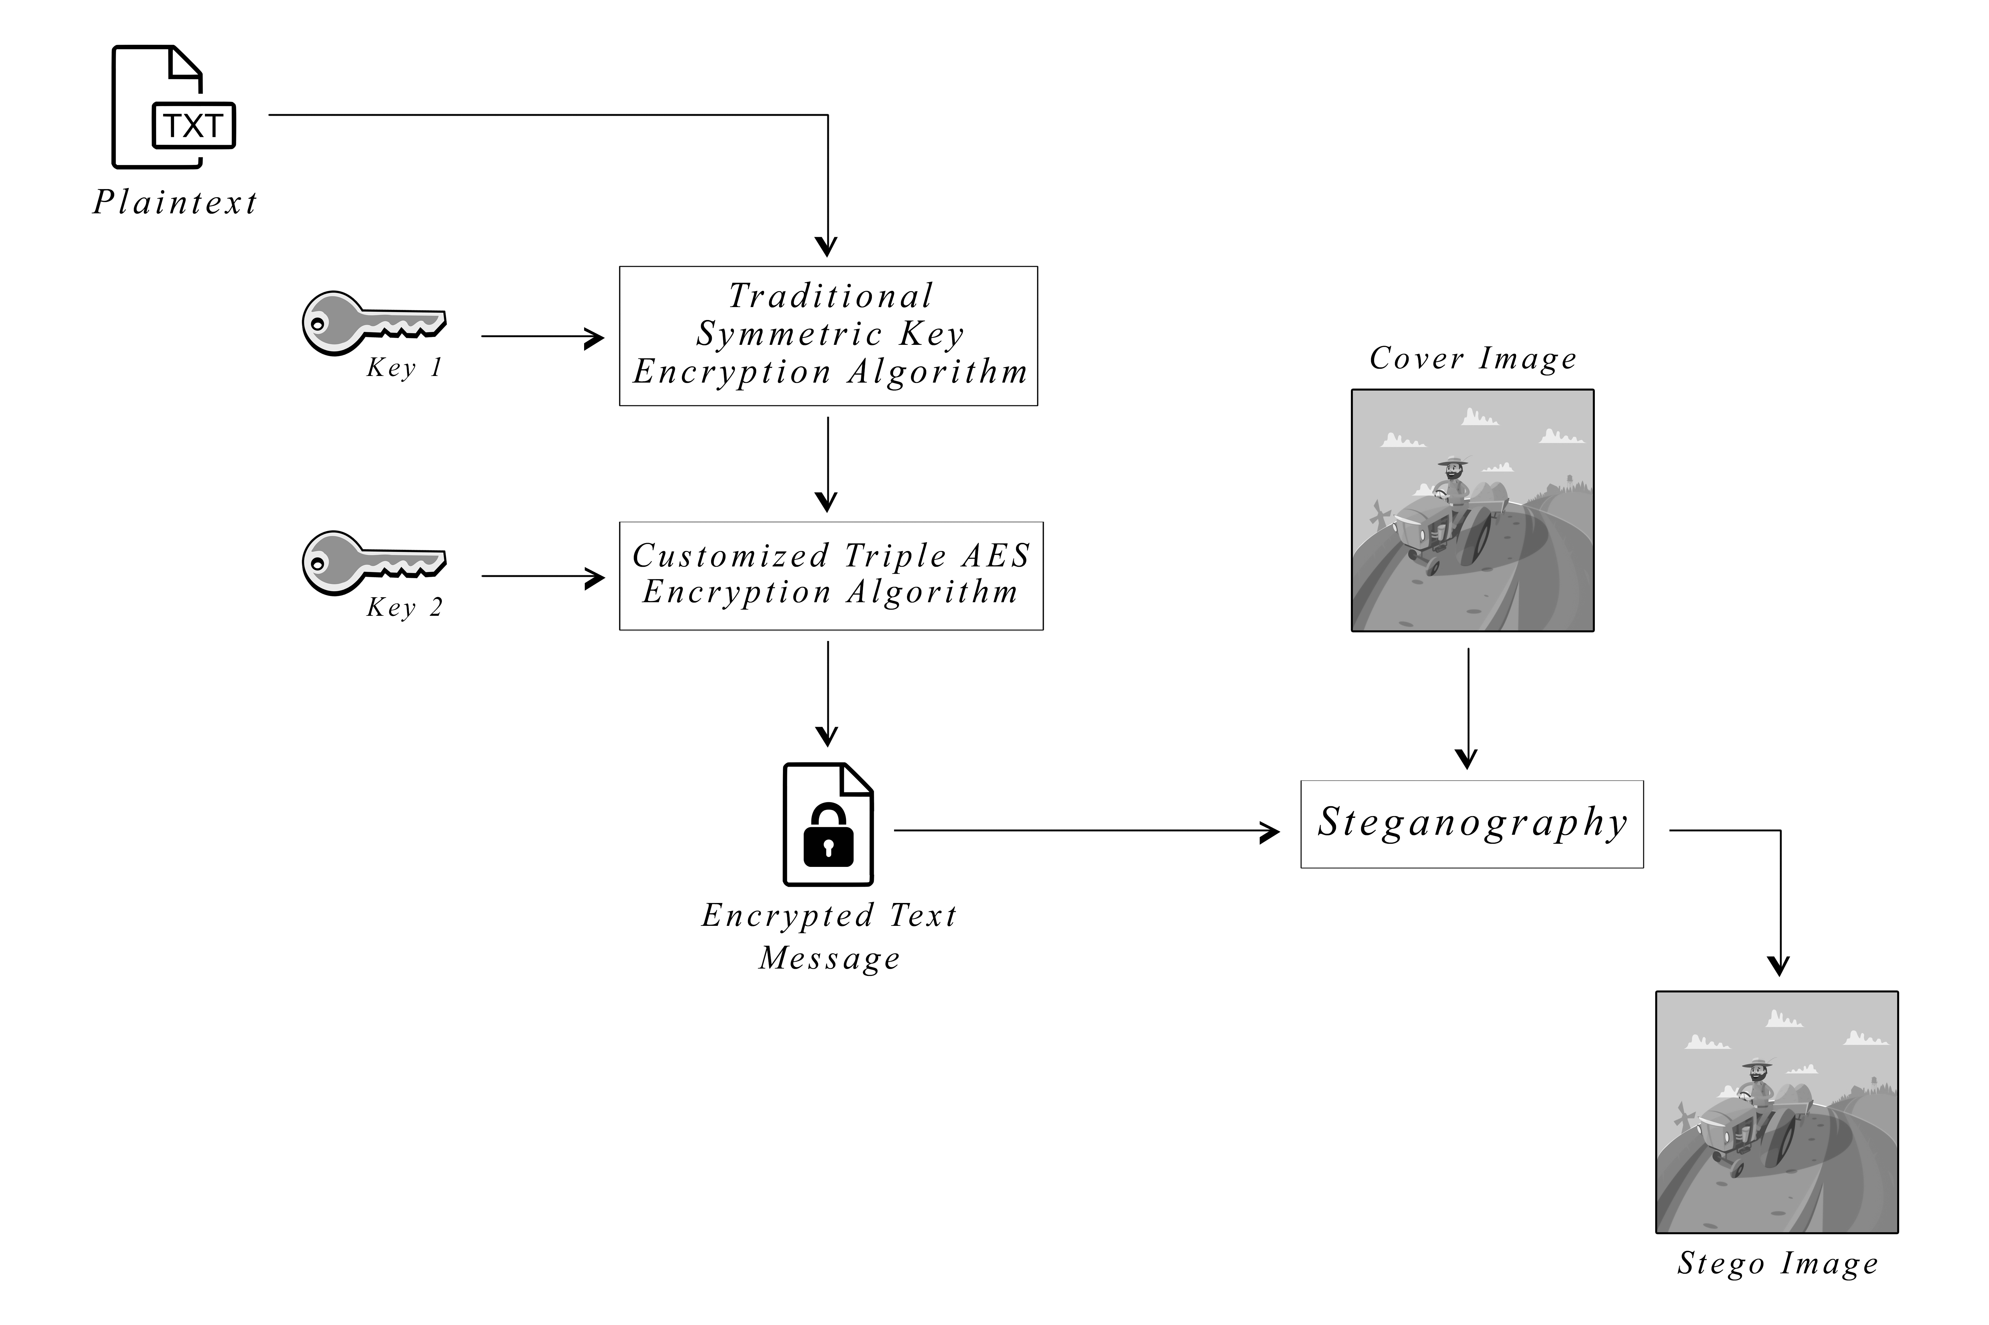
ENCRYPTION BLOCK DIAGRAM

Slide 5
DECRYPTION:
→ This Algorithm is used to decrypt the encrypted stego image.
→ The user should first choose the stego image. At this stage ,the user have to enter
Key 1 and Key 2 , set when the image was encrypted.
→ Thus we can decrypt the image and the hidden message can be seen.

Slide 6
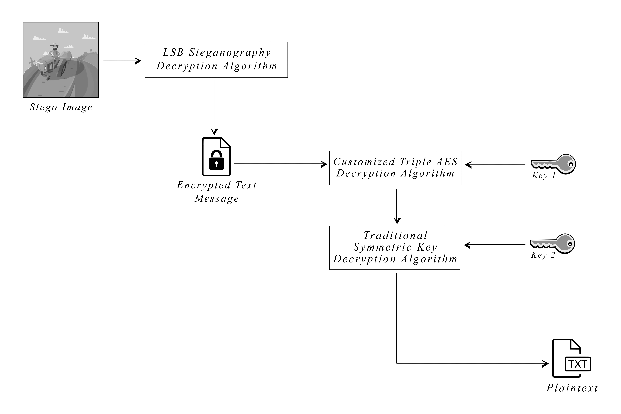
DECRYPTION BLOCK DIAGRAM

Slide 7
Existing System
LSB Steganography:
Least Significant Bit Steganography is a steganography technique in which we hide messages inside an image by replacing Least significant bit of image with the bits of message to be hidden.
The Least Significant Bit (LSB) method is the easiest way to embed secret information.

Slide 8
Proposed System
→ Combination of Cryptography and Steganography:
The combination of cryptography and steganography, also known as "cryptosteganography" involves using both techniques to secure a message.
→Traditional Symmetric Key Encryption Algorithms Used: 1. Vigenère Cipher 2. Beaufort Cipher
3. Autokey Cipher
4. Porta Cipher

Slide 9
Proposed System
Triple AES: 3AES (Triple Advanced Encryption Standard) is a variant of the Advanced Encryption Standard (AES) encryption algorithm, which is a widely used standard for encrypting electronic data.
Mode of 3AES : ECB (Electronic Code Book) is a mode of operation for a block cipher that allows a plaintext block to be encrypted independently of all other plaintext blocks.
In ECB mode, the same plaintext block always produces the same cipher text block

Slide 10
Proposed System
PKCS7 Algorithm: Public Key Cryptosystem Standard #7 is commonly used for padding and unpadding data.
SHA-256 HASH FUNCTION: Secure Hash Algorithm -256 is a cryptographic hash function that generates a fixed size of output of 256 bits or 32 bytes.

Slide 11

Software Requirements
Visual Studio Code: Microsoft Visual Studio Code (VS Code) is a free, open-source code editor developed by Microsoft. It is available for Windows, mac OS, and Linux, and supports a wide range of programming languages and development frameworks.

Slide 12




Languages Used
HTML
CSS
JavaScript
Python

Slide 13
Conclusion and Future scope
Highly secured and advanced system.
Secure and efficient data transfer over the internet.
A new way of hiding information in an image with less variation in image bits have been proposed.

Slide 14
THANK YOU!

